Slide 1



Presentation on Local DRRM Fund
Office of Civil Defense

Slide 2

Background LDRRM Fund
Section 21. Local Disaster Risk" Reduction and Management Fund (LDRRMF). - The present Local Calamity Fund shall henceforth be known as the Local Disaster Risk Reduction and Management Fund (LDRRMF). Not less than five percent (5%) of the estimated revenue from regular sources shall be set aside as the LDRRMF to support disaster risk management activities such as, but not limited to, pre-disaster preparedness programs including training, purchasing life-saving rescue equipment, supplies and medicines, for post-disaster activities, and for the payment of premiums on calamity insurance. The LDRRMC shall monitor and evaluate the use and disbursement of the LDRRMF based on the LDRRMP as incorporated in the local development plans and annual work and financial plan. Upon the recommendation of the LDRRMO and approval of the sanggunian concerned, the LDRRMC may transfer the said fund to support disaster risk reduction work of other LDRRMCs which are declared under state of calamity.
Of the amount appropriated for LDRRMF, thirty percent (30%) shall be allocated as Quick Response Fund (QRF) or stand-by fund for relief and recovery programs in order that situation and living conditions of people In communities or areas stricken by disasters, calamities, epidemics, or complex emergencies, may be normalized as quickly as possible.
Unexpended LDRRMF shall accrue to a special trust fund solely for the purpose of supporting disaster risk reduction and management activities of the LDRRMCs within the next five (5) years. Any such amount still not fully utilized after five (5) years shall revert back to the general fund and will be available for other social services to be identified by the local sanggunian.

Slide 3
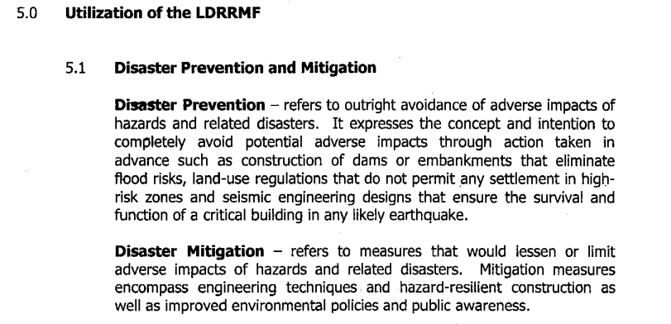
DILG-DBM JMC 2013 - 01

Slide 4
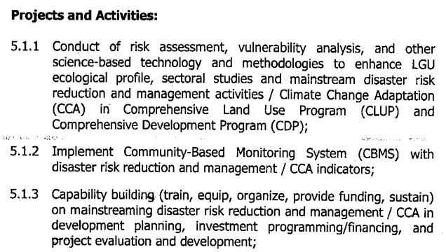
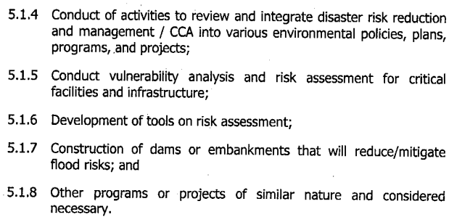
DILG-DBM JMC 2013 - 01

Slide 5
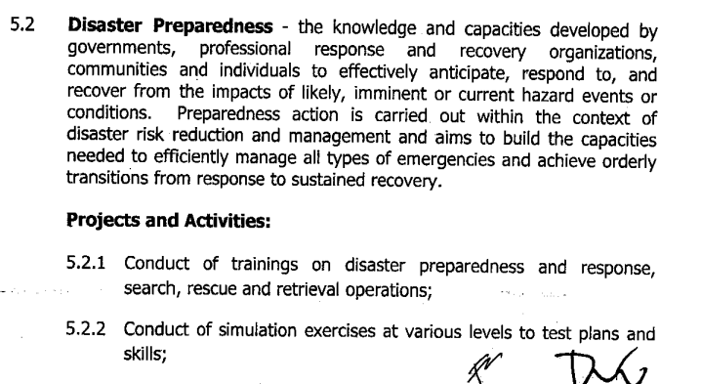
DILG-DBM JMC 2013 - 01

Slide 6
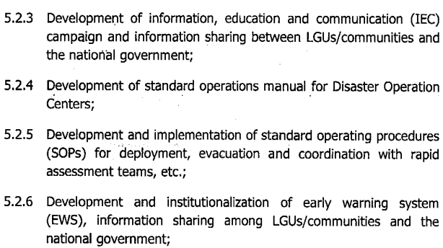
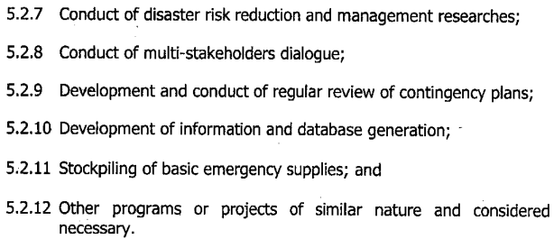
DILG-DBM JMC 2013 - 01

Slide 7
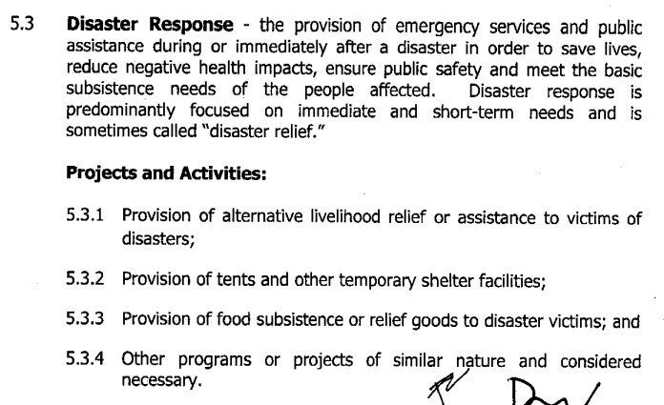
DILG-DBM JMC 2013 - 01

Slide 8
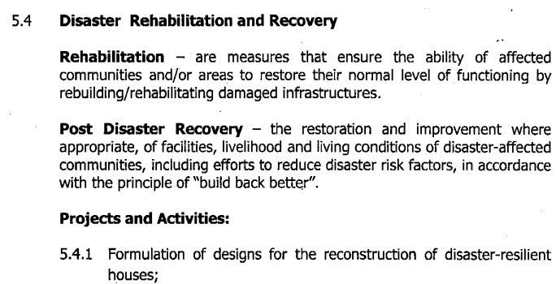
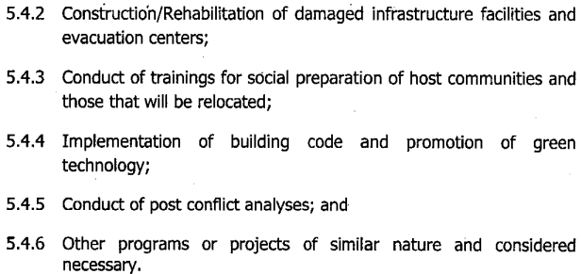
DILG-DBM JMC 2013 - 01

Slide 9
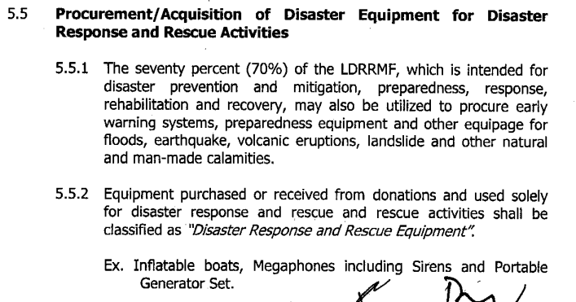
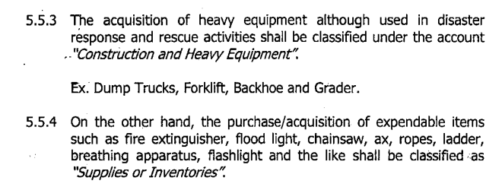
DILG-DBM JMC 2013 - 01

Slide 10
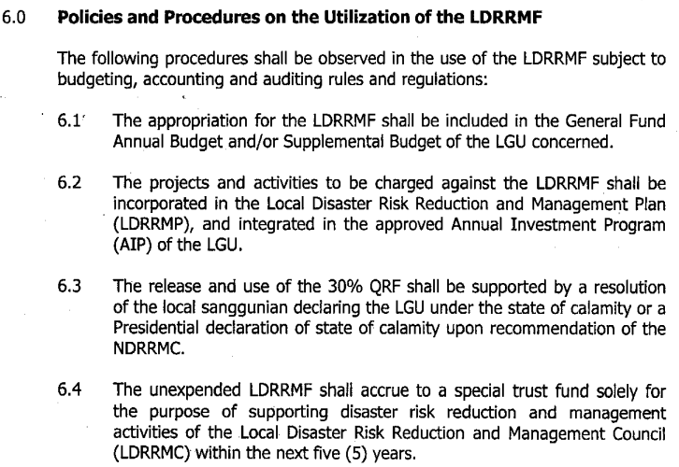
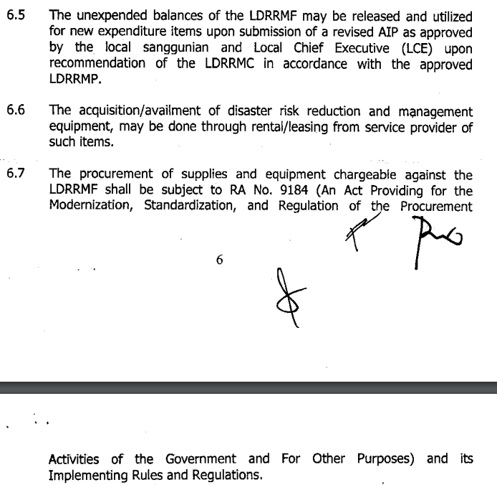
DILG-DBM JMC 2013 - 01

Slide 11
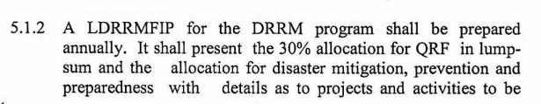
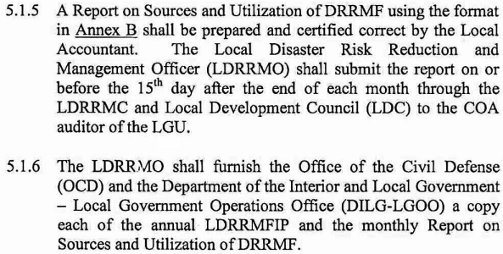
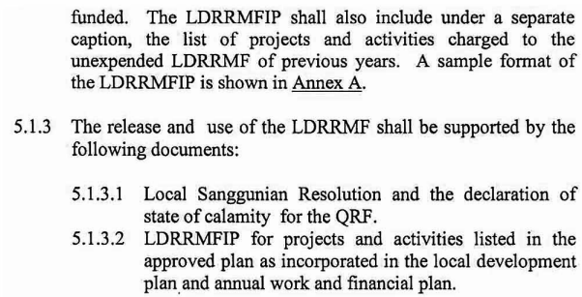
COA CIRCULAR 2012-002

Slide 12
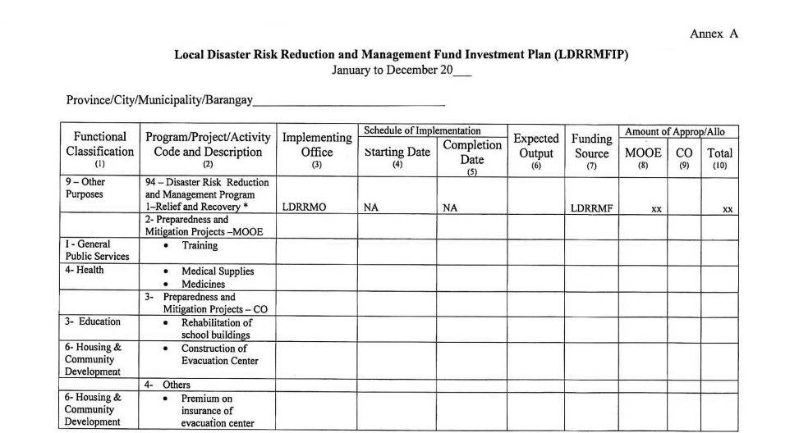
COA CIRCULAR 2012-002

Slide 13
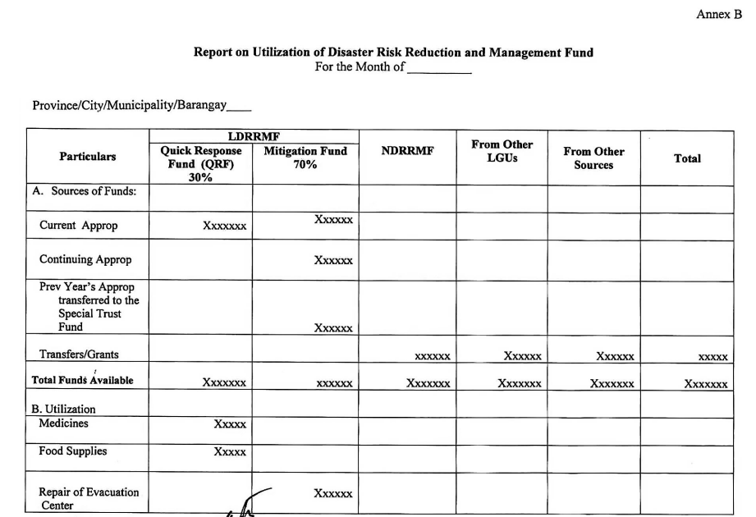
COA CIRCULAR 2012-002

Slide 14
Local Disaster Risk Reduction and Management Fund
of the estimated revenue from regular sources shall be set aside as the LDRRMF
Based on the LDRRMP
LDRRMC to monitor
Quick Response Fund (QRF)
Pre-disaster
Post-disaster
*Section 21, RA 10121, COA 2012-002
Notes:
Local DRRM Fund (LDRRMF)
As the LDRRMCs develop and implement risk reduction programs, projects, and activities (PPAs), the Local DRRM Fund, among others may be utilized, and equally important, is to be subject for monitoring. Based from RA 10121, the previously known “calamity fund” is now known as Local DRRM Fund.
Note to Facilitator:
Ask participant if the LDRRMF can be more than 5% or can be lower than 5%?
Emphasize that the use of the LDRRMF, should be in accordance with the LDRRMP.
This will be discussed in greater detail in Module 3: thematic area planning and budgeting.

Slide 15
LDRRMP?
Notes:
Note to Facilitator:
Ask participants if they are familiar with the LDRRMP, what is the first thing that comes to mind when they hear LDRRMP, or what does it mean for them?
Alternatively, ask who among them has experiences in LDRRMP, be it training, formulation/updating, review, risk assessment, and other related topics.

Slide 16
strengthen local capacities
build resilience
Reduce
Eliminate
institutionalize
Enhance capacities
disaster & climate risks
L D R R M P
16
Notes:
The LDRRMP refers to the comprehensive and integrated plan formulated and implemented at the provincial, city, municipal, or barangay level, in accordance with the national, regional, and provincial framework and policies on disaster risk reduction (RA 10121).
It aims to strengthen local capacities to build resilience of communities, and to institutionalize arrangements and measures for reducing, if not totally eliminating, disaster risks including projected climate risks, and enhancing disaster preparedness and response capacities.
In the course overview, we learned about the enhanced LDRRMP Guidebook. This material aims to help LGUs better prepare their respective LDRRMPs. Let’s look at what’s in each stage.
Note to Facilitator:
Ask participants that if these are what we hope to achieve in our localities by developing the LDRRMP, what do they think are essential components or procedures in developing the LDRRMP?
Take note of the responses and relate them to the contents of the succeeding slides.

Slide 17
more proactive
addressing the root causes
focus to disaster risk reduction (DRR)
more emphasis on strengthening people’s capacities
R.A. 10121: The Philippine Disaster Risk Reduction and Management Act of 2010*
gender responsive
sensitive to indigenous knowledge systems
respectful of human rights
*Sec.2 – Declaration of Policy (a-d), (j)
Notes:
Republic Act 10121: The Philippine Disaster Risk Reduction and Management Act of 2010
This paved the way for a paradigm shift in the country’s disaster management system from one primarily focused on response and preparedness for response to one focused on a more proactive approach in reducing and managing disaster risks.
It principally mandates LGUs, among others, to “adopt a disaster risk reduction management approach that is holistic, comprehensive, integrated, and proactive in lessening the socio-economic and environmental impacts of disasters including climate change, and promote the involvement and participation of all sectors and all stakeholders concerned, at all levels, especially local community.” Moreover, Section 2 (Declaration of Policy) includes the provisions that the State shall ensure that disaster risk reduction and climate change measures are “gender responsive, sensitive to indigenous knowledge systems, and respectful of human rights”.
Among the salient features of RA 10121 here include:
more proactive approach to managing disaster risks
impacts of disasters can be reduced by addressing the root cause of disaster risks
shifts focus from disaster response to disaster risk reduction (DRR)
more emphasis on strengthening people’s capacity to absorb stress, maintain basic functions during a disaster and bounce back better from disasters
It is among our realizations that disasters won’t go away until we address the risks and vulnerabilities. If we can remember the bigger slice of the framework, in what thematic area is it? – Prevention and Mitigation.
Note to Facilitator:
You may mention that for “gender responsiveness”, this is also engendered in the principles of “social inclusion”.
Note to Facilitator:
Ask participants if they think disasters can go away. In here we can stress that addressing the risks and vulnerabilities is key to risk reduction.
In relation to the first bullet, ask participants who may be familiar already with the Philippine DRRM framework if they can remember which thematic area has a now bigger ‘slice’ (focus). In here the answer is Prevention and Mitigation.

Slide 18
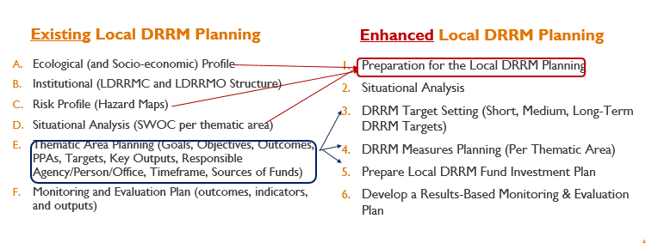

Slide 19
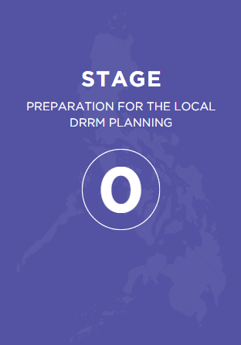
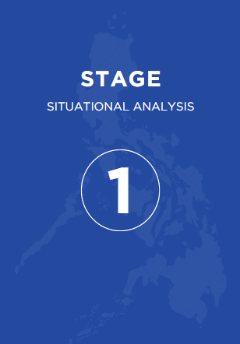
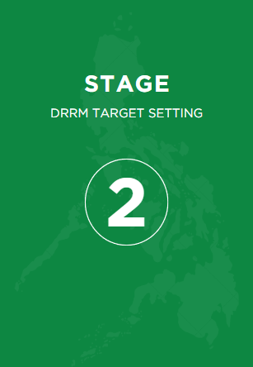
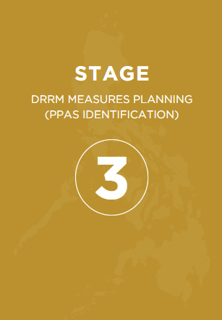
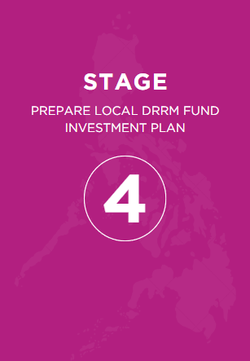
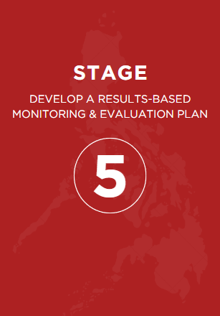

Slide 20
Local DRRM Planning
Stage 0: Preparation for the Local DRRM Planning
 | Steps | Outputs
0-1 | Organize the Local DRRM Planning Team (LDRRM-PT) | Executive Order designating members of LDRRM-PT (Form 0-A) Schedule for the Formulation of the LDRRMP (Form 0-B) (if applicable) SWOC-PESTEL Analysis Matrix (Form 0-C) LDRRMP Toolkit
0-2 | Set Commitment and Identify Target Milestones
0-3 | Gather Basic Data
0-4 | Conduct Climate and Disaster Risk Assessment
0-5 | Identify Vulnerabilities and Capacities
0-6 | Review the Technical Findings
Notes:
Through this stage, LGU will form a team (LDRRM-PT) to ensure the following: a) the active involvement of stakeholders; b) the formulation of risk-informed LDRRMP; c) the considerations on gender-responsiveness and inclusivity; and d) to ensure the alignment to the national and related local plans.
In addition, initial analysis of data and documents will be conducted.
Expected outputs, as indicated in the guidebook include:
Executive Order designating members of LDRRM-PT (Form 0-A)
Schedule for the Formulation of the LDRRMP (Form 0-B)
(if applicable) SWOC-PESTEL Analysis Matrix (Form 0-C)
LDRRMP Toolkit

Slide 21
Local DRRM Planning
Stage 1: Situational Analysis
 | Steps | Outputs
1-1 | Revisit the existing DRRM Plans and Efforts | NDRRMP Checklist Assessment (Form 1-A) Review of the Current / Previous LDRRMP (Form 1-B)* LDRRMP Toolkit
1-2 | Review related Development Plans
1-3 | Review Infrastructures Plans
1-4 | Classify what is ongoing, what is planned
1-5 | Understand how Disaster Risk may change/Optimizing Residual Risks
1-6 | Anticipate Future Impacts from Disasters
Notes:
In this stage, the LDRRM-PT will examine and align or integrate the LDRRMP with the targets, activities, and policies stipulated at the national and local level.
Resulting from the validation of the initial considerations done in Stage 0, the LDRRM-PT will anticipate the actual and future damages cause by climate and disaster risk and consider the issues related to each sector.
Expected outputs, as indicated in the guidebook include:
NDRRMP Checklist Assessment (Form 1-A)
Review of the Current / Previous LDRRMP (Form 1-B) → This will be replaced by the LDRRMP M&E form 4: Mid-Term Assessment and End-Term Evaluation
LDRRMP Toolkit
Note to Facilitator:
Please note that an adjustment in the training course materials is the integration of the SWOC to the ‘Situational Analysis’.

Slide 22
Local DRRM Planning
Stage 2: DRRM Target Setting
 | Steps | Outputs
2-1 | Review the Current Situation, Analysis Results | DRRM vision for the LGU (Free Format) LDRRMP Toolkit
2-2 | Formulate the Vision Statement
2-3 | Setting LDRRMP Goals
2-4 | Set the DRRM Targets in Relation to Elements at Risk (short, medium, long-term targets)
Notes:
Through this stage, LDRRM-PT will set concrete and feasible targets based on the climate and disaster risk assessment and result of the current capacities, and align and/or adopt the NDRRMP’s goals and outcomes.
Expected outputs, as indicated in the guidebook include:
DRRM vision for the LGU (Free Format)
LDRRMP Toolkit

Slide 23
Local DRRM Planning
Stage 3: DRRM Measures Planning (PPAs Identification)
 | Steps | Outputs
3-1 | Understand the importance of Comprehensive DRRM Measures Planning | LDRRMP Toolkit PPA Alignment with Outcomes (Form 3-A)
3-2 | Identify areas where DRRM measures should be applied to
3-3 | Consider the DRRM measures needed to achieve DRRM targets
3-4 | Evaluate the effects of DRRM measures / How residual risk will change
3-5 | Select priority DRRM measures to be included in the LDRRMP period
3-6 | Classify the DRRM measures per thematic area
3-7 | Check Alignment of PPAs with Target Outcomes
Notes:
Through this stage, LDRRM-PT will deepen understanding on comprehensive DRRM measures planning including the actions taken by National Governmental Agencies, communities, private sector, and other stakeholders; list all measures needed to achieve the DRRM targets, and select the most effective DRRM measures to prioritize in the short-medium-long term-planning horizon per thematic area (prevention and mitigation, preparedness, response, and early recovery, rehabilitation, and recovery).
Expected outputs, as indicated in the guidebook include:
LDRRMP Toolkit
PPA Alignment with Outcomes (Form 3-A)

Slide 24
Local DRRM Planning
Stage 4A: Prepare Local DRRM Investment Program
 | Steps | Outputs
4A-1 | Revisit the list of PPAs | LDRRMP Toolkit
4A-2 | Budgeting of PPAs
4A-3 | Prepare the LDRRM Investment Program
Stage 4B: Supplemental Investment Program for the Special Trust Fund
 | Steps | Outputs
4B-1 | Review availability of Special Trust Fund (Unexpended LDRRMF)
4B-2 | Prepare LDRRMFIP for the Special Trust Fund (Unexpended LDRRMF)
Notes:
Through this stage, LDRRM-PT will identify corresponding funding requirements of the PPAs indicated in the short-medium-long term targets; map out possible fund sources, option, and complementation; and determine the allocation of the Special Trust Fund based on the approved LDRRMP.
Expected outputs, as indicated in the guidebook include:
LDRRMP Toolkit

Slide 25
Local DRRM Planning
Stage 5: Develop a Results-Based Monitoring & Evaluation Plan
 | Steps | Outputs
5-1 | Assess the Current M&E Practices of the LDRRMC | Cumulative Quarterly Monitoring Template (LDRRM M&E Form 2) (Optional) Scoping Matrix Practices (Form 5-B) (Optional) Assessment of the Current Monitoring and Evaluation Practices (Form 5-C)
5-2 | Build knowledge on Results-based M&E
5-3 | Revisit Goals and Outcomes
5-4 | Prepare the Results-based M&E Plan
5-5 | Monitor and Report the Results
5-6 | Establish an M&E Team
Notes:
This stage will help the LGUs understand the current Monitoring and Evaluation (M&E) practices of the LDRRMC; formulate a Results-based M&E plan; and identify and organize the M&E committee.

Slide 26
Disaster Risk Reduction and Management Councils
Coordination during emergencies
1
NATIONAL DRRM COUNCIL
DRRMC | Affected LGUs
Barangay | 1 Barangay
City / Municipal | 2 or more Barangays
Provincial | 2 or more Cities/Municipalities
Regional | 2 or more Provinces
National | 2 or more Regions
17
REGIONAL DRRM COUNCILS
82
PROVINCIAL DRRM COUNCILS
149
CITY DRRM COUNCILS
1,493
MUNICIPAL DRRM COUNCILS
42,011
BARANGAY DRRM COMITTEES
*from PSA data as of September 30, 2024
26
Notes:
National, Regional, and Local DRRM Councils
Leading the climate and disaster risk reduction efforts in the country, are the disaster risk reduction and management councils. Within them, the NDRRMC is the highest body of DRRMC leading the implementation of DRRM in the country. The DRRMC who will lead will be the LGU. The next higher LGU will be there to provide support. The matrix on the right side of the slide shows support arrangements between DRRMCs during emergencies.
It is important for LGUs to understand these information.

Slide 27
Policy | Guidance on LDRRMF Utilization
NDRRMC-DBM-DILG-JMC 2013-1 | Guidelines for the allocation and utilization of the LDRRMF
DILG Memorandum No. 2012-73 | detailed menu of activities that can utilize the LDRRMF
COA Circular No. 2012-002 | Provides for the accounting and reporting of LDRRMF
JMC __: | Revised Guidelines on the Allocation and Utilization of the Local Disaster Risk Reduction and Management Fund (LDRRMF)
*LDRRMF utilization shall adhere to procurement requirements per RA 9184 and its revised IRR
Notes:
Shown on the slide are policies related to LDRRMF utilization, which the LDRRMCs can further refer to:
Note to Facilitator:
Check for updates on the policies.
NDRRMC-DBM-DILG-JMC 2013-1 - provides for the guidelines for the fund’s allocation and utilization. The JMC was issued as a supplemental reference to further guide the LGUs in the allocation and utilization of the LDRRMF in accordance to the four (4) DRRM thematic areas.
DILG Memorandum No. 2012-73 - provides detailed menu of activities that can utilize the LDRRMF. The DRRM activities enumerated in the Memorandum are just examples to guide the LGUs in their planning activities. The LGUs can have many other DRRM activities as needed.
COA Circular No. 2012-002 - provides guidelines for the accounting and reporting of LDRRMF. It is intended to provide detailed steps for accounting such as the accounting codes as well as the reporting requirements.

Slide 28
DILG-DBM JMC 2013 - 01

Slide 29
Background NDRRM Fund
Section 22 of RA 10121. National Disaster Risk" Reduction and Management Fund. shall be used for:
disaster risk reduction or mitigation, prevention and preparedness activities
relief, recovery, reconstruction and other work or services for calamities which may occur during the budget year or past two (2) years from the budget year.
released upon approval of the President of the Philippines in accordance with the favorable recommendation of the NDRRMC
thirty percent (30%) shall be allocated as Quick Response Fund (QRF) for relief and recovery programs for disaster-affected areas to be normalized as quickly as possible.

Slide 30
Changes in the New Guidelines
Initial allocation of ten percent (10%) of the NDRRM Fund for disaster preparedness, prevention and mitigation prioritizing low-income and high-risk LGUs. Any increase in the said allocation in the succeeding years shall be subject to the approval of the Chairperson, NDRRMC;
QRF be utilized not just for disaster response but for early recovery;
QRF replenishments from NDRRM Fund shall be subject to SND’s favorable recommendation to DBM prior to release of funds;
Documentary requirements were lessened from six to thirteen (6-13) to three to five (3-5);
Timeline for processing were streamlined from eight to eleven (8-11) months to four to five (4-5) months

Slide 31
Phases of DRRM Financing Assistance
Phase | Purpose | Basis (Control Measures) | Funding Source | Implementation Timeline
Pre-Disaster Interventions | Disaster Preparedness, Prevention and Mitigation | DRRM Plans, Menu of Projects | NDRRM Fund | Whole Year
Emergency Response | Immediate Actions (Live saving and life sustaining) | Situation Report (SitRep) | QRF | During Disaster up to 1 month
Early Recovery Interventions | Return to Normalcy (Short-Term Immediate Needs) | SitRep, RDANA | QRF Regular Agency Budgets NDRRMF | 2 Weeks to maximum of 1 year after disaster occurrence
Rehabilitation and Reconstruction | Build Back Better (Medium to Long Term Needs) | PDNA and RRP or RP-VET | NDRRMF, Regular Agency Budgets | 4months after disaster occurrence up to 3-5 years depending on the impact

Slide 32

DISASTER PREPAREDNESS, PREVENTION AND MITIGATION

Slide 33
Process Flow Pre-Disaster Interventions
Increased Capacity
6
5
Transmittal of Request to OP for approval
Sub-Total OCD&DND:
7-12 Working days
4
Approves and signs recommendation letter to OP
OCD CO
3
Endorsement to SND of Letter to OP
1-2 Working Days
SND/C, NDRRMC
2
3-5 Working Days
1 Week
OCD CO
RDRRMC
3-5 Working Days
OCD RO reviews, recommend, endorse to NDRRMC thru OCD CO
1
Not Later than End of June Every Year
LGU
1-2 Weeks
Submission of proposal w/ complete documentary requirements
RDRRMC
Identification and Call for Proposal for Priority LGUs

Slide 34
Menu of Projects (Pre-Disaster)
Establishment Local Emergency Operations Centers and its equipage;
Construction of local evacuation centers and other local infrastructure projects for disaster prevention and mitigation based on national standard design;
Construction of other local and national DRRM facilities in accordance with the NDRRM Plan;
Construction/Establishment of training centers and facilities for DRRM;
Establishment of early warning systems;
Procurement of emergency telecommunications equipment and systems for geographically isolated LGUs;
Procurement of mission essential vehicles and equipment;
Conduct of risk assessments and other research for DRRM;
Trainings and capacity building for LGU DRRM personnel;
Support to GK LGU Awardees;
Other priority programs and projects recommended by the NDRRMC Preparedness, Prevention and Mitigation Pillar, or the ED, NDRRMC/A, OCD subject to approval of the Chairperson, NDRRMC

Slide 35
Documentary Requirements
Endorsement Letter from Head of Agency or Local Chief Executive; Work and Financial Plan for non-infra or Project Design documents Program of Works, Detailed Engineering Design for infra-related requests (DBM BED Form); Certificate of Unavailability of Funds with LDRRM Fund and Special Trust Fund Report (for LGUs); Certification of Capability to Implement Infrastructure Project (For LGUs) Certificate of Inclusion of Proposed Project in LDRRMP from concerned OCDRO (for LGUs); Counter-part funds for 1st to 3rd Income Class Municipalities.

Slide 36
Emergency Response

Slide 37
Process Flow for Phase II – Emergency Response
Life Saving and Sustaining
6
If QRF insufficient, proceed to Step 3
5
Transmittal of Request to DBM for approval
4
Sub-Total OCD&DND:
7-12 Working days
Approves and signs recommendation letter to DBM
Sub-Total OCD&DND:
7-12 Working days
3
OCD CO
Endorsement to SND of Letter to DBM
1-2 Working Days
Endorsement to SND of Letter to OP
SND/C, NDRRMC
2
1-2 Weeks
3-5 Working Days
Response Agency
Preparation and Submission of Documents for QRF Augmentation from NDRRMF
OCD CO
1
During Impact
OCD CO
3-5 Working Days
Response Agencies
Pre-Impact
Conduct response activities such as but not limited to evacuation, search and rescue, provision of food and non-food items
PDRA Core Team
Assess potential impacts of hazard, pre-position resources

Slide 38
Documentary Requirements
Letter from Agency Head
Work and Financial Plan (DBM BED Form)
QRF Utilization Report

Slide 39
Menu of Projects (Disaster Response)
Procurement of food and non-food items;
Logistical expenses for pre-positioning of resources;
Deployment of assets such as but not limited to search and rescue teams and equipment, emergency telecommunications, water and sanitary supplies, generator sets;
Support to camp-management of displaced populations;
Other priority programs and projects recommended by the NDRRMC Response Pillar and approval of the Chairperson, NDRRMC

Slide 40
EARLY RECOVERY

Slide 41
Process Flow for Phase III – Early Recovery Interventions of NGAs
Return to Normalcy
6
NGAs initially provide funds for program implementation.
5
Transmittal of Request to OP for approval
Sub-Total OCD&DND:
7-12 Working days
4
Approves and signs recommendation letter to OP
OCD CO
3
Endorsement to SND of Letter to OP
1-2 Working Days
SND/C, NDRRMC
2
3-5 Working Days
1-2 Weeks
OCD CO
Implementing Agency
3-5 Working Days
Request Preparation and Submission for Budget Augmentation from NDRRMF
1
1-2 Weeks
Early Recovery Cluster
1-2 Weeks
Presentation of RDANA Result, Agreement on Priority Needs for Funding Using QRF and Agency Budgets
RDANA Team
Assessment of Initial Damages and Needs for Early Recovery

Slide 42
Documentary Requirements
Endorsement Letter from Agency Head
Work and Financial Plan (DBM BED Form)
QRF Utilization Report if applicable

Slide 43
Menu of Projects (Early Recovery)
Social Protection Programs such as emergency cash transfer, shelter assistance, cash-for-work, rental subsidy programs;
Livelihood Support such as credit assistance, support for MSMEs, skills training;
Agricultural Support such as provision of seeds, fertilizers, equipment, and other interventions;
Repair and Restoration of power and water supply;
Debris Clearing and minor repair of damaged roads and bridges and its auxiliary parts; or setting up of temporary bridges to restore transport; and
Repair of damaged schools and hospitals with minor damages, replacement of damaged equipment.

Slide 44
REHABILITATION AND RECONSTRUCTION

Slide 45
Process Flow for Phase IV – Regional Project Validation and Evaluation Team Assessment
4
Disaster with minor damages
1 to 3 months
5
Sub-Total Pre-Requisite(N/R DRRMC):
2 – 4 weeks and 3 days
3
Requesting Party (NGAs, **LGUs) Submission of proposal w/ complete documentary requirements
2
3 working days
OCD RO reviews, recommend, endorse to NDRRMC thru OCD CO
RDRRMC
Endorses priority list
1
1-2 weeks
6
Total OCD & DND:
2 to 4 weeks
RPVET Actual Inspection.
Determination of LGU Capacity
3-5 Working Days
1-2 weeks
Review Damage and RDANA Report, Call for Proposal
Review of Proposal and Endorsement to SND
7
8
OCD CO
Approves and signs recommendation letter to OP
3-5 Working Days
Transmittal of Request to OP for approval
Sub-Total OCD&DND:
12-17 Working days
SND/C, NDRRMC
3-5 Working Days
OCD CO
1-2 Working Days

Slide 46
Process Flow for Phase IV – With PDNA and RRP (If Necessary)
Disaster with disruptive damages
6
5
Transmittal of Request to OP for approval
4
Approves and signs recommendation letter to OP
Sub-Total OCD&DND:
7-12 working days
Sub-Total Pre-Requisite(N/R DRRMC):
3 months
OCD CO
3
Review of Proposal and Endorsement to SND
SND/C, NDRRMC
1-2 Working Days
1-3 months
3-5 Working Days
2
OCD CO
Requesting Party (NGA/LGU)
Submission of proposals with complete documentary requirements for the identified priorities
3-5 Working Days
Timeline:
3 ½ mos. plus additional 1-3 mos. for
proposal preparation
1
1 month
Crafting of Rehab & Recovery Plan
2 months
▪Identification of Priorities for NDRRMF Funding
▪Determination of LGU Capacity
Conduct of PDNA

Slide 47
Menu of Projects (Rehabilitation and Reconstruction)
Major repair or reconstruction of roads and bridges and its auxiliary parts (e.g. collapsed road and bridges, slope protection, road slip, etc.).
Major repair/reconstruction of damaged schools, hospitals, and other public buildings such as evacuation centers, municipal halls, etc.
Repair/rehabilitation/reconstruction of damaged irrigation facilities.
Repair/rehabilitation/reconstruction of damaged disaster mitigating structures such as flood control, dikes, river control, sea wall, etc.
Resettlement Program for displaced population.
In the case of El Niño, priority programs and projects identified in RRP or by the concerned RDRRMC.

Slide 48
Documentary Requirements
Non-Infrastructure Projects
Endorsement Letter from LCE or Agency Head with Project Proposal Template Work and Financial Plan with List of Target Beneficiaries (for Resettlement Projects) Social Awareness and Consultations for Beneficiary Community/Family (for Resettlement Projects) Certificate of Land Availability. Transfer Certificate of Title or Deed of Sale or Donation for Resettlement Projects)
Infrastructure Projects
Endorsement Letter from LCE or Agency Head with Project Proposal Template Project Design documents Program of Works, Detailed Engineering Design, etc. Calamity Damaged Report with Geotagged and Time-Stamped Photo Certificate of Unavailability of Funding (For LGUs accompanied by LDRRM and Special Trust Fund and Received NDRRM Fund Utilization Report – COA Stamped Certification from DPWH of compliance to standard design and costing (If LGU wants to implement the project) Certification of Capability to Implement Infrastructure Project (If LGU wants to implement the project) Hazard Assessment of Project Location (for Reconstruction/Construction of Damaged Facility to a New Location)

Slide 49
RP-VET Functions
Agency | Functions
Office of Civil Defense (OCD) | Serve as Secretariat Activate RP-VET, identify lead and participating agencies depending on the type of project Participate in project validation and evaluation Check completeness of documents. Inform LGUs of lacking documents. Prepare endorsement to OCD Central Office Track LGU proposals and update LGU on status of requests Provide technical assistance to LGUs, as necessary
Department of Public Works and Highways (DPWH) | Lead the project validation and evaluation for infrastructure projects Review technical documents, designs, scope and costing and if necessary, recommend revisions to comply with national standard Determine and certify LGU capability to implement project Provide technical assistance to LGUs, as necessary
Department of the Interior and Local Government (DILG) | Assist in project validation and evaluation Assist in determining and certifying LGU capability to implement project in terms of financial housekeeping and governance Provide technical assistance to LGUs, as necessary
Other Agencies | RDRRMC concerned may call for other regional line agencies to assist in the evaluation and validation of the proposal (e.g. DENR-MGB, DOST PhiVolcs for hazard assessment, etc.)

Slide 50
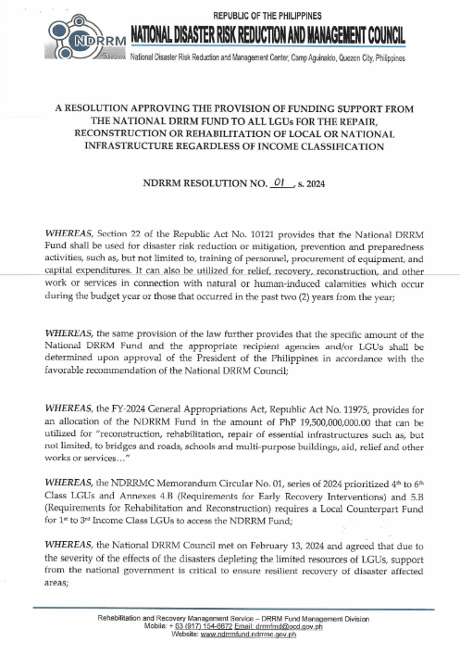
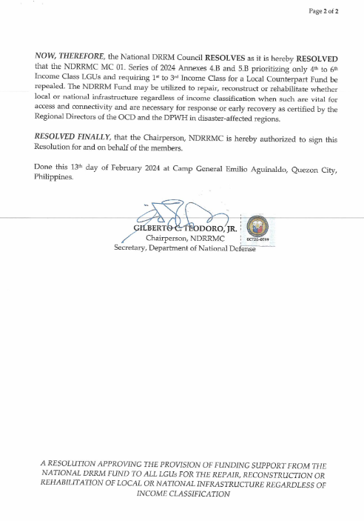
NDRRMC Resolution on LGU Access to NDRRMF

Slide 51
Thank You!

